Slide 1


Geography and History Projects
Team Codebusters

Slide 2
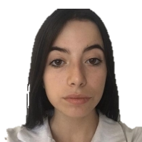



Our team
Elina Genova
Iliyana Michevska
Vanesa Kardzheva
Elena Keserdzhieva

Slide 3
Design
Color scheme
+ game photos or smth

Slide 4
PROCESS
Idea
Front-end
Back-end
Finished product

Slide 5






Used technology

Slide 6
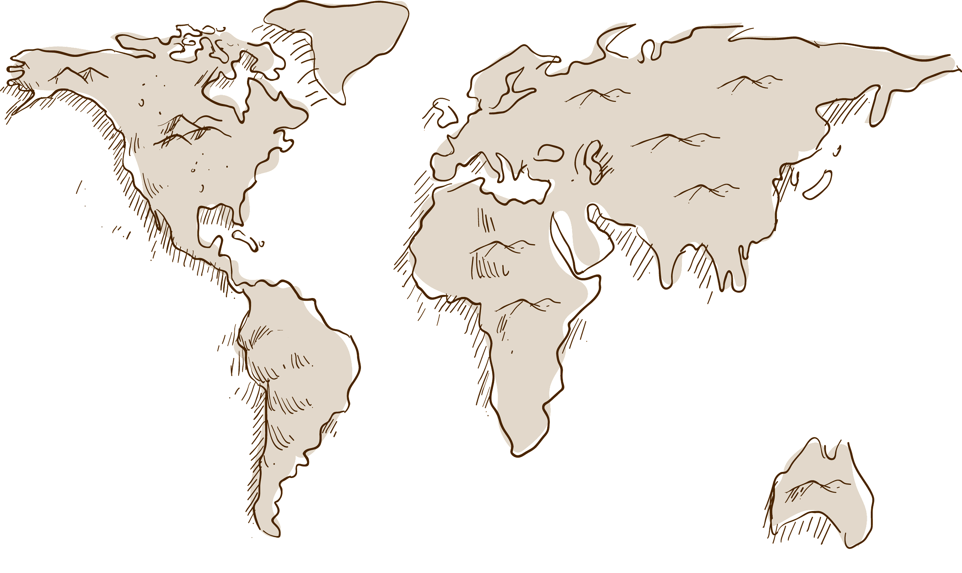
Demonstration

Slide 7
Thank you for your time!

